Slide 1
How to use soundcloud
By victoria berggren

Slide 2
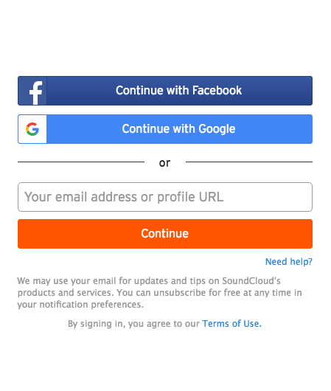
creating an account
First, create a login using Facebook, Google, or a current email account

Slide 3

Confirm email address
Before you can make any changes to your profile, you must confirm your email address

Slide 4
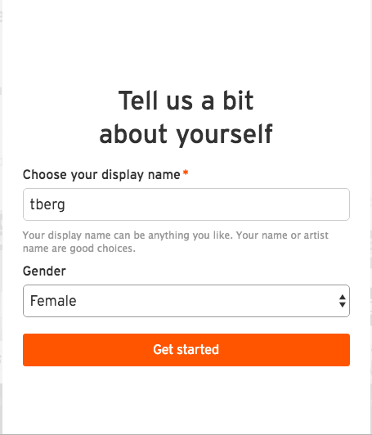
Add personal information
Add personal information to help viewers find your audio pieces

Slide 5
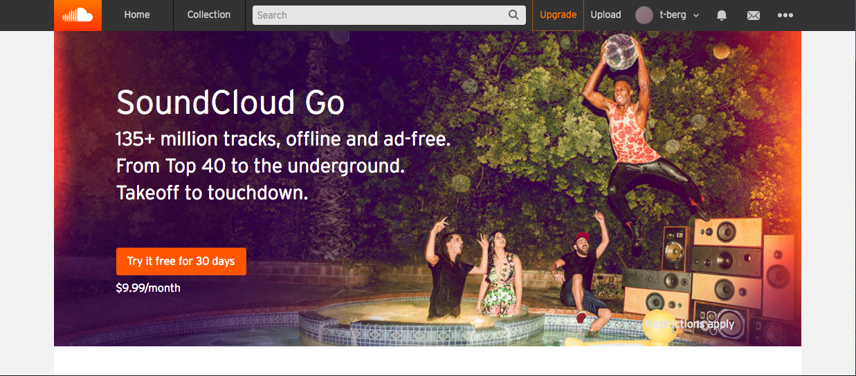
Upload audio
Once you have created your profile you are now ready to upload.
Click the upload button in the right hand corner to begin the process

Slide 6
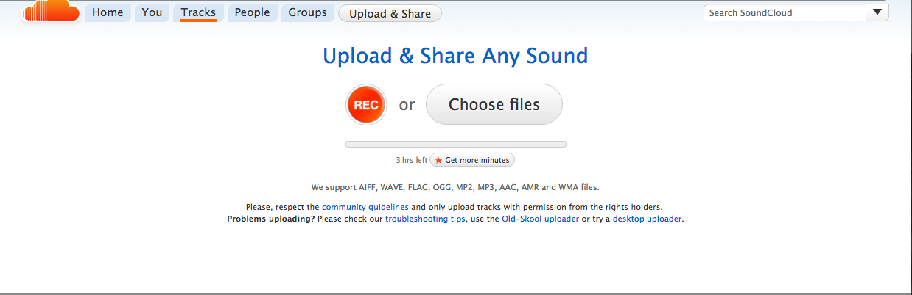
Record or upload audio
You have the option to upload a preexisting piece of audio or record from scratch.
If you post one from your computer, make sure to use compatible files such as MP2 and Mp3

Slide 7
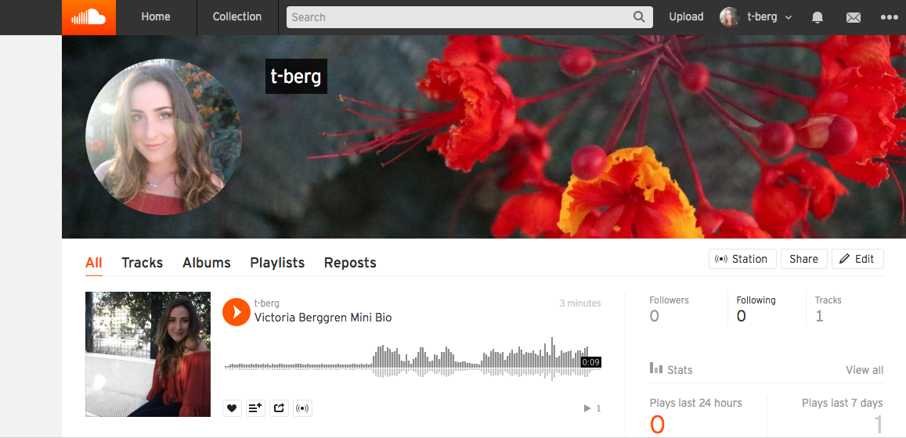
Share ☺
Once you have saved your audio, you now have a profile that you can share with your friends, family, and colleagues.

